Slide 1
Our journey has begun
“Far from what I once was but not yet what I’m going to be”

Slide 2
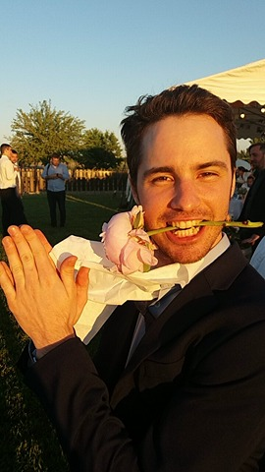
WEEKEND

Slide 3
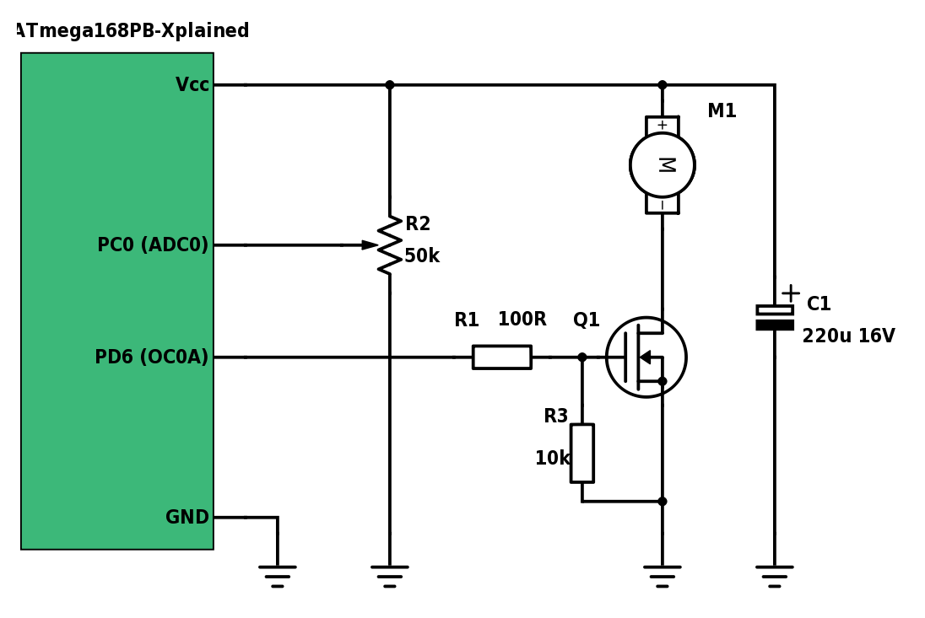

First day
Pwm
FAN control with PWM
Controlling PWM duty cycle via UART

Slide 4
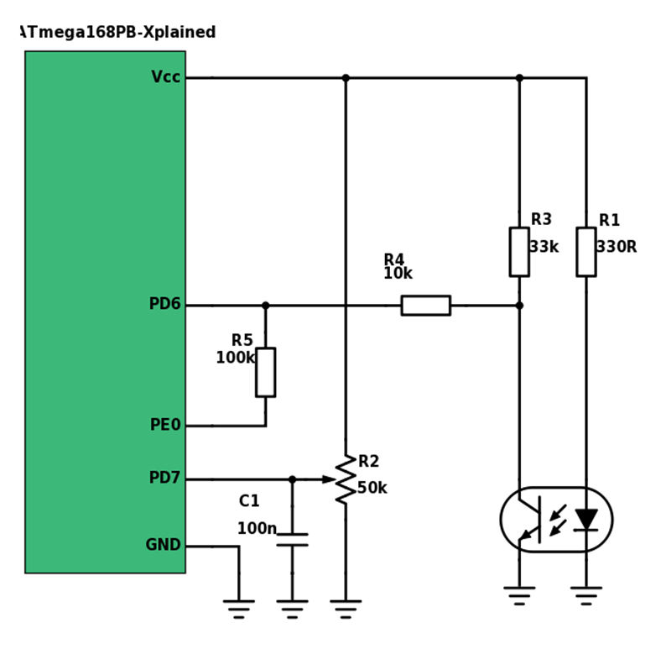
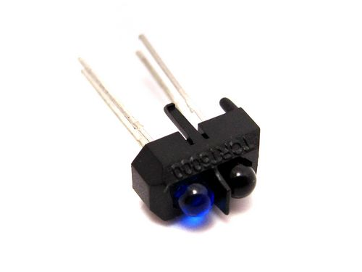
Second day
RPM measurement
Frequency measurement
Low energie

Slide 5
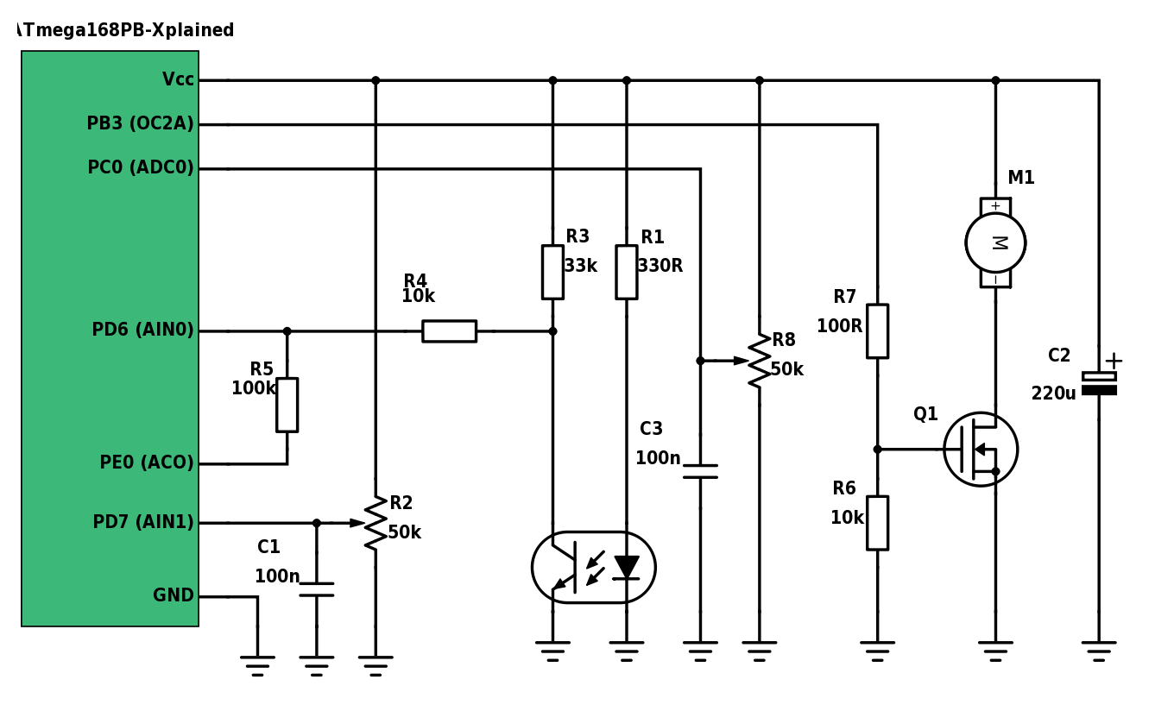
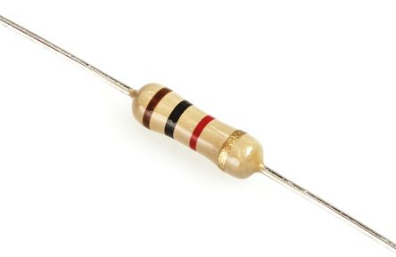
Third day
Putting things all together
Training
Feeling awful
Enemy is below

Slide 6

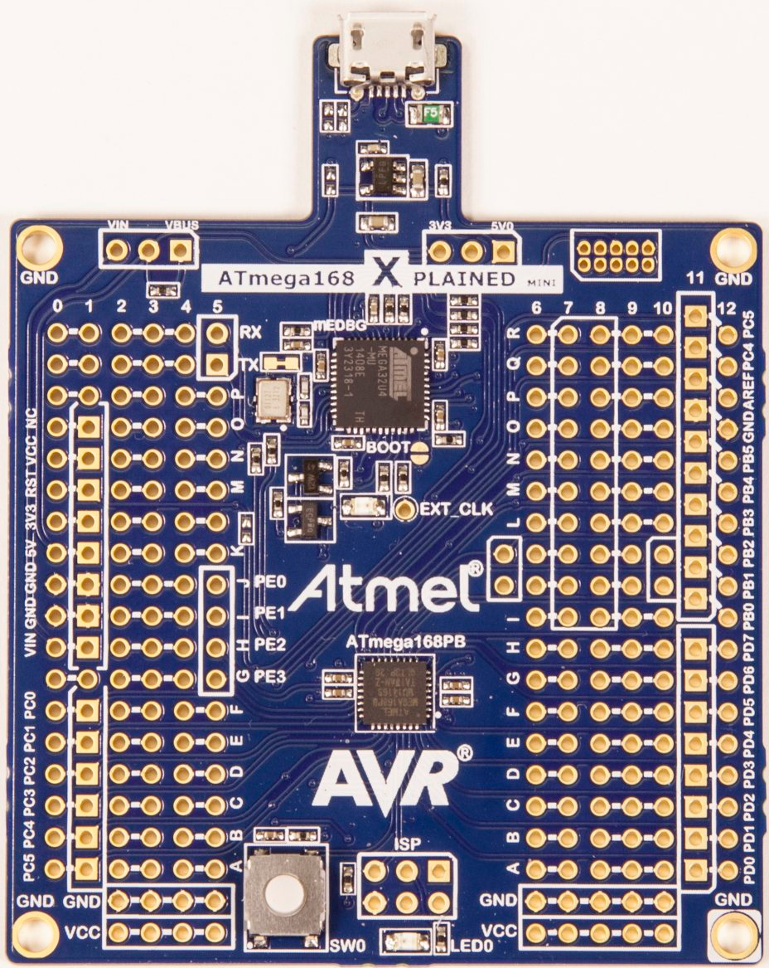
fourth day
Getting better
Things are going smoothly
Love

Slide 7
Fifth day
Finally something to show

Slide 8
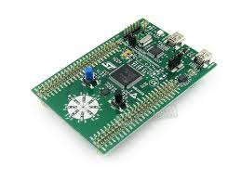
New love

